Slide 1
Uganda Food Price Prediction Using Machine Learning
Predicting Food Prices Using Historical Market Data
Project Presented by: Nasasira Praise Dataset: World Food Programme (WFP) Uganda Food Prices Dataset Project: Machine Learning Predictive Modeling August 2026

Slide 2
PROJECT OVERVIEW,PROBLEM STATEMENT & OBJECTIVES
Problem statement
Food prices in Uganda vary depending on factors such as the commodity, location, market and time.
This makes it difficult to estimate prices accurately.
My main objective was therefore to explore historical food price data, identify important patterns and build a predictive machine learning model.
Objectives
Analyze historical food price patterns.
Identify factors associated with food prices.
Prepare the data for machine learning.
Develop and compare predictive models.
Identify the best-performing model.

Slide 3
DATASET
Dataset Description
Source: World Food Programme(WFP). Global Food Prices Database. Humanitarian Data Exchange(HDX) Link: https://data.humdata.org/dataset/wfp-food-prices Country: Uganda Observations:30933 Features: 16 Target: Food Price

Slide 4
Main Variables
Variable | Description
Date | Date of observation
Admin1 / Admin2 | Location
Market | Market information
Commodity | Food product
Category | Food category
Unit | Measurement unit
Pricetype | Retail / wholesale
Price | Target variable

Slide 5
DATA PREPARATION
Before modelling,the following steps were performed:
Checked data types and dataset structure
Checked for missing values and duplicates
Cleaned the dataset
Created year and month features from the date
Encoded categorical variables
Selected relevant prediction features
Split the data into training and testing sets

Slide 6
EXPLORATORY DATA ANALYSIS (EDA)

Slide 7
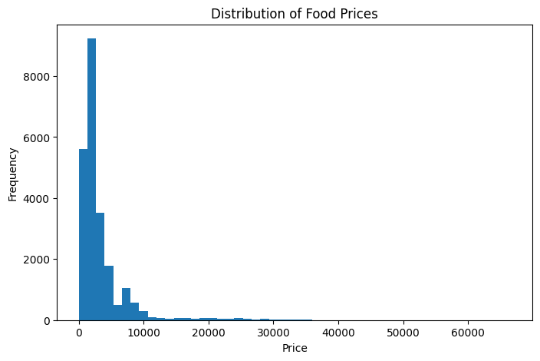
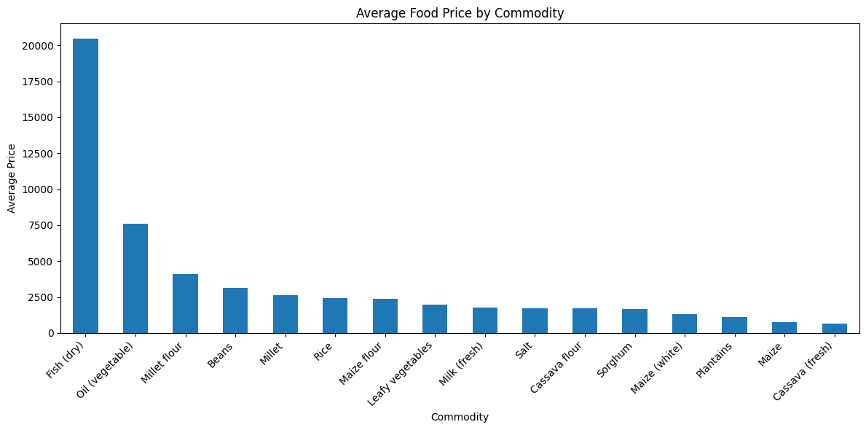
Price distribution histogram, Average price by commodity and Average Food Price Over Time

Slide 8
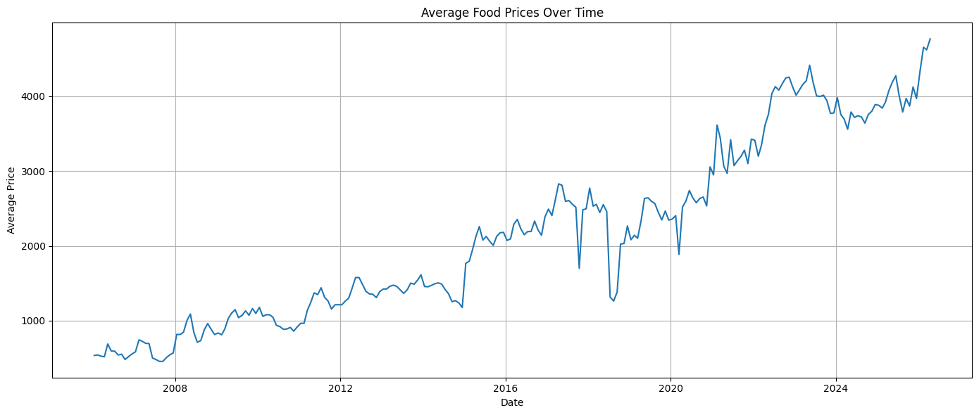

Slide 9
Key Findings
Food prices were positively skewed with most observations at lower price levels while some commodities had much higher prices.
Fish (dry) and vegetable oil were among the higher-priced commodities.
Cassava (fresh) was among the lower-priced commodities.
Average food prices generally increased over time though with some seasonal fluctuations.

Slide 10
MACHINE LEARNING
Machine Learning Approach
After preparing and encoding the data, I trained two machine learning models: a Random Forest model and a Neural Network
Evaluation Metrics
MAE — Mean Absolute Error
RMSE — Root Mean Squared Error
R² — Coefficient of Determination

Slide 11
MODEL COMPARISON RESULTS
Random Forest
MAE: 335.20
RMSE: 1242.19
R²: 90.74%
Neural Network
MAE: 702.64
RMSE: 1513.58
R²: 86.25%
The Random Forest model performed better than the Neural Network. It achieved an MAE of 335.20, an RMSE of 1242.19 and an R-squared of 90.74%, compared with 86.25% for the Neural Network. Therefore, Random Forest was selected as the best-performing model

Slide 12
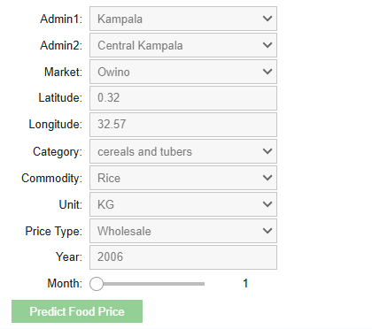
Food Price Prediction Demo
I also developed a working prediction interface where a user can provide information about a food commodity and market conditions and receive a predicted food price.
Administrative region
Market
Commodity
Category
Unit
Price type
Year
Month
Latitude and longitude
Output
Predicted Food Price

Slide 13
KEY FINDINGS & RECOMMENDATIONS
Key Findings
Food prices vary considerably between commodities.
Prices generally increased over the period analyzed.
Commodity type was an important factor in price prediction.
Random Forest provided the strongest predictive performance.
The model achieved 90.74% R² on the test data.
Recommendations
Use predictive analytics to support food security planning.
Support farmers and traders with better price information.
Use updated data to continuously improve the model.
Future models could include weather, inflation, fuel prices and seasonal production.

Slide 14
Conclusion
This project showed that historical food price data can be used to identify important price patterns and build a machine learning model for food price prediction. The Random Forest model produced the strongest performance among the models tested.
Future Improvement
The project could be improved in the future by incorporating additional factors such as inflation, weather, seasonal conditions and other economic indicators to predict food price in Uganda.
Thank You

Slide 15
Github Repository access link.
https://github.com/nasasirapraise/wfp-uganda-food-price-prediction

